Slide 1
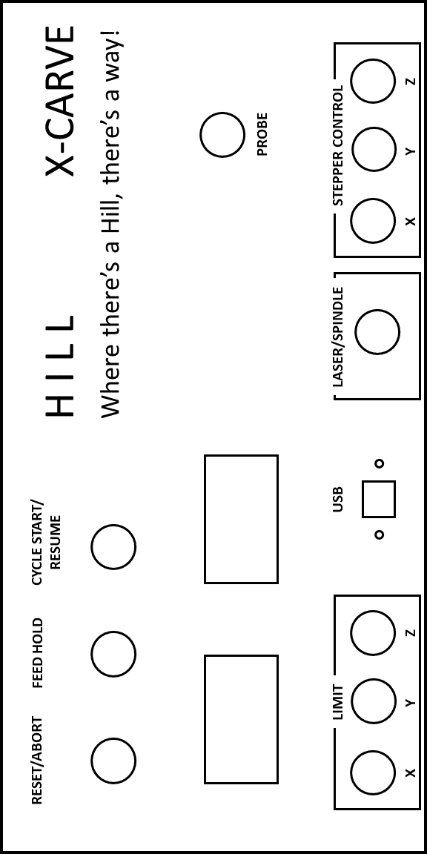
Probe
4
3
2
1
Z
Arduino
Z
4
3
2
1
5v
Reset 3.3V
5V
GND
GND
Vin
A0 Reset/Abort
A1 Feed Hold
A2 Cycle Start/Resume
A3 Coolant Enable
A4 (not used/reserved)
A5 Probe
AREF
GND 14
13
Limit Z 12
Spindle Enable 11
Limit Y 10
Limit X 9
Stepper Enable/Dis 8
G-shield
4
3
2
1
2 Y- steppers- this picture is generically showing the axis
Y
Y
4
3
2
1
4
3
2
1
X
X
Gnd
V
4
3
2
1
N-Of f
N-On
Ground Block
Back Panel
L
X, Y, Z
V
Power Supply (Switching Power Supply 400W 24V 16.7A for CNC Router Kits 115V/230V S-400-24)
Green box is adapter from Inventables
N
C
Gnd
Gnd
- V
No
-
Spindle/Laser
+
V+
NC

